Slide 1
Visual Question Answering Increment#3
Team Members:
Avni Mehta
Santosh Yadav Jada
Harshil Lavjibhai Patel
Trinadha Rajeswari Muppala

Slide 2
Objective
Dataset
To implement the visual question answering system that would answer open ended free-form questions of natural language like English.
The model will be trained on thousands of images in order to extract the important features of these images using CNN and Inception.
The most famous dataset for VQA is MS COCO dataset.
Owing to lack of hardware resources, we will use a small subset of the dataset.
Domain selected : Interiors

Slide 3
Feature Specification
In this project increment, we have focused on TensorFlow inception model for our for interiors (bedroom, bathroom, kitchen, living) data.
Managed to create a bounding box around the image using Darknet
Integrated Spark API, Clarifai and TensorFlow with our web application
Initiated developing an android application but could not proceed as Spark and TensorFlow can only run via ionic

Slide 4
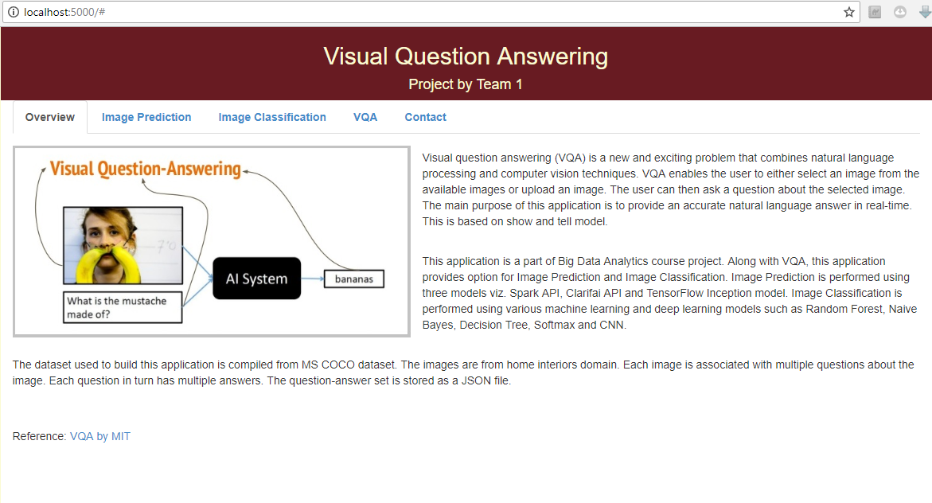
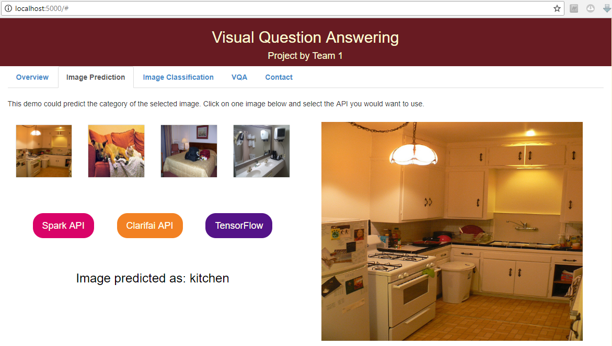
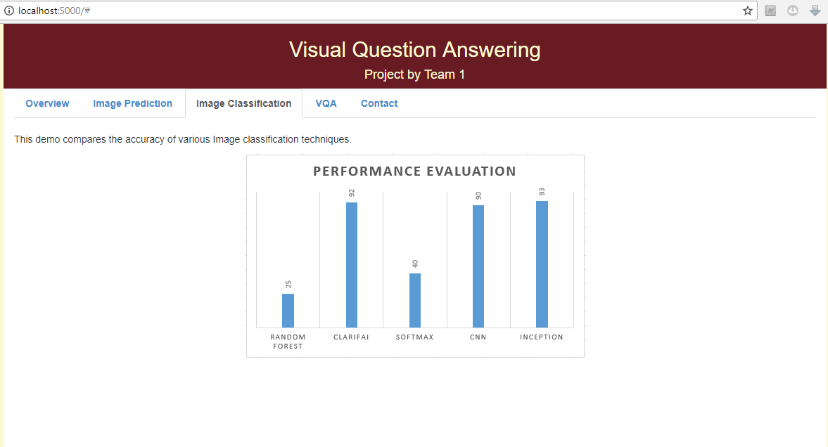
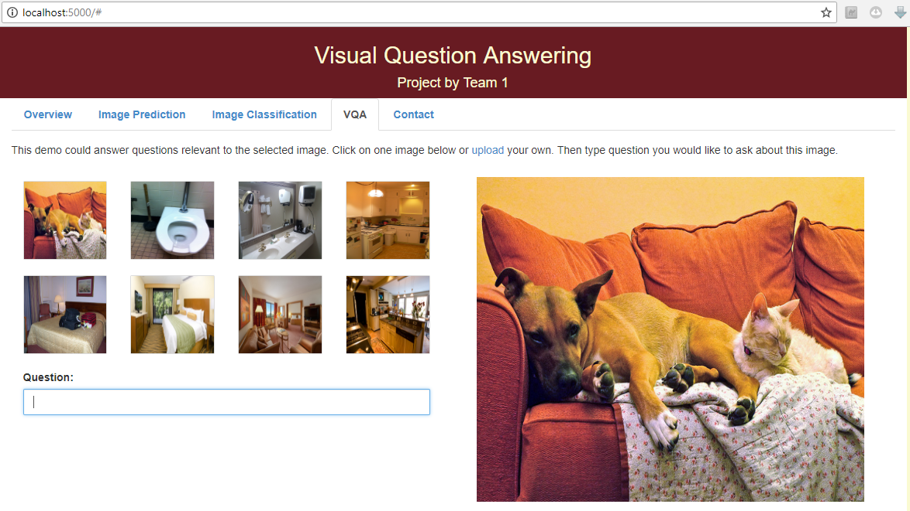

Slide 5
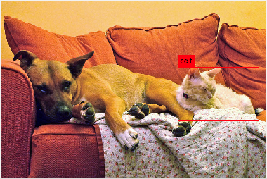
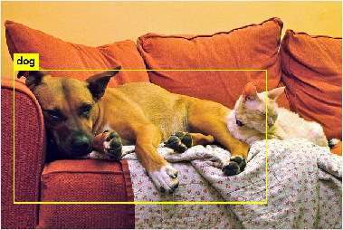
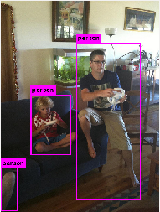

Slide 6
Next steps..
Integration of the web model to Darknet.
Challenges!
Building the model for bounding box
Integrating Spark API and TensorFlow API in pure android application

